Slide 1
Title: Crime Records Analysis and Visualization System Presented by: Tharunteja Nakkala

Slide 2
Project Overview
Objective: Develop a system to collect, analyze, and visualize crime data to identify patterns and trends.
Tools Used:
Python
MySQL
NumPy, Pandas
Matplotlib, Seaborn
Dataset: Crime data from 2020 to present​

Slide 3
System Architecture
Data Collection: User inputs via CLI
Database: MySQL for structured data storage
Data Processing: Python libraries utilizing Pandas and NumPy
Visualization: Matplotlib and Seaborn for graphical representations Data Entry Interface
Features:
Add new crime records
View existing records
Export data to CSV and JSON formats
Analyze data through visualizations

Slide 4
Data Analysis Techniques
Temporal Analysis: Identifying crime patterns over time
Spatial Analysis: Assessing crime distribution across cities
Correlation Analysis: Examining relationships between variables (e.g., weapon used and arrest rate)
Seasonal Trends: Analyzing crime variations across different seasons​
Visualization - Crime Types Distribution
Description: Bar chart showing the frequency of different crime types
Insights: Identifies the most common crimes

Slide 5
Visualization - Victims by City
Description: Bar chart representing the total number of victims per city
Insights: Highlights cities with higher victim counts​ Visualization - Arrest Rate by Weapon Used
Description: Bar chart depicting arrest rates associated with different weapons
Insights: Reveals which weapons are more likely to lead to arrests Visualization - Crimes by Season
Description: Pie chart illustrating the distribution of crimes across seasons
Insights: Shows seasonal crime trends​

Slide 6
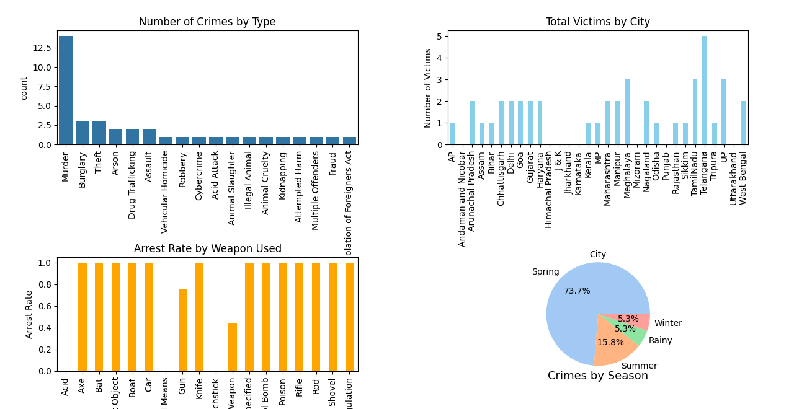

Slide 7
Key Findings
Night-time crimes constitute a significant portion of total crimes.
Certain cities exhibit higher crime rates, necessitating focused interventions.
Weapons used in crimes influence the likelihood of arrests.
Seasonal patterns affect crime rates, with certain seasons showing spikes. Future Enhancements
Integration of Geospatial Analysis: Incorporate GIS for detailed mapping.
Predictive Modeling: Utilize machine learning to forecast crime trends.
Web-Based Interface: Develop a user-friendly web application for broader accessibility.​

Slide 8
Conclusion The project successfully analyzes and visualizes crime data from 2020 to present
Helps identify crime types, locations, time patterns, and arrest rates.
Makes it easy to understand crime trends using tables and graphs.
Useful for police departments, government, and researchers.
Can be extended in future with more features like prediction and web interface.
The system provides valuable insights into crime patterns, aiding law enforcement and policymakers.
Data-driven approaches can enhance public safety and resource allocation.

Slide 9
Challenges Faced
Data cleaning was needed due to missing or wrong values.
Some queries were slow when handling large files.
Making clear and simple graphs was a bit tricky.
Designing a good database structure took time. Acknowledgements
Thanks to trainers and mentors for their support.
Thanks to the team or friends who helped in the project.

Slide 10
THANK YOU

